Slide 1
Guitar handtracking
Echipa:
Butnaru Raimond-Eduard (1306B)
Guriuc Vlad-Ionut (1306B)

Slide 2
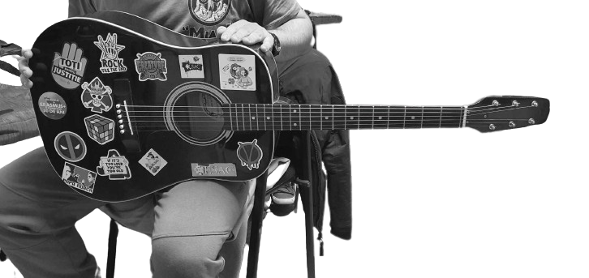
1. Masca pentru fundal

Slide 3
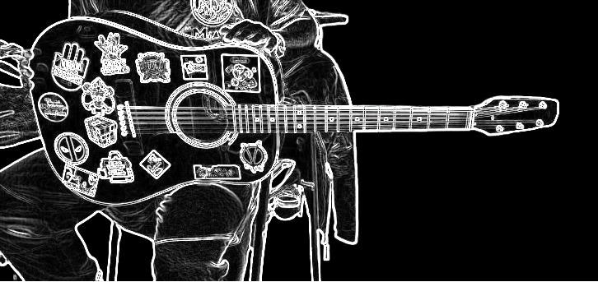
2. Canny edge detection

Slide 4
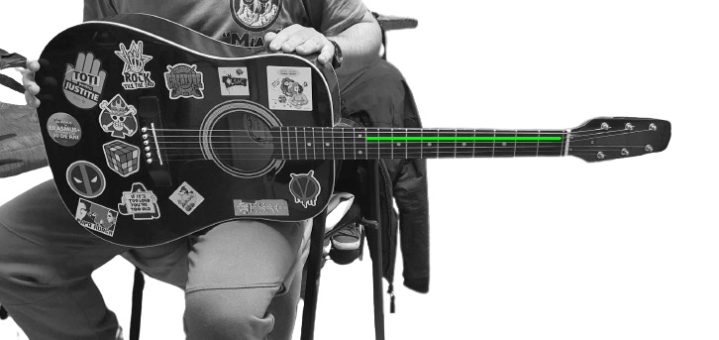
3.Transformata hough probabilistica

Slide 5

4. Decupare si rotire

Slide 6

5.A. canny + sobel

Slide 7

5.b. canny + sobel

